Slide 1


Design & Develop Front End Community Portal
Module Project
Module: NICF-UI Frameworks
Course: NICF-Advanced Certificate in Web Development
Start Date :28 November 2022
End Date : Submission Date :
Learner Name Enrollment ID
:
:
Syukur Sidiq Nur Alam
21 Desember 2022
bdse-0922-089
21 Desember 2022
Presentation Date :

Slide 2
Document History
Version Number | Effective Date of release | Summary of Included Changes | Author
1 | 4th March 2016 | First Edition | Satya CVS
2 | 7th April 2017 | Changed for Module 2 | Shrinivas K R
3 | 14th May 2017 | Changed for Module 3 | Shrinivas K R
4 | 03rd May 2018 | Changed for RQF | Shrinivas K R
5 | 16th Sep 2018 | Change for Java Track | Shrinivas K R

Slide 3
Contents
S. No. | Description
01 | Development Tools
02 | Feedback Techniques
03 | Pages Inventory
04 | Forms & Pages Design
05 | Forms & Pages Feedback
06 | HTML Pages
07 | Usability Metrics
08 | User Interaction Steps
09 | User Interaction Flowchart
10 | Current & Desired Usability
11 | Prototype Screen
12 | Prototype Feedback
13 | Usability Test
14 | Project Milestones & Tasks
15 | Milestone Feedback & Action taken
16 | Project Results
17 | Proposed Improvements

Slide 4


1. Development Tools
Development Tools
Laptop Dell Latitude 3420
Windows 11
Chrome
Axure
Fake Filler Chrome

Slide 5

2. Feedback Techniques
Feedback gathering techniques
interview
Utilizing Interviews to gather user feedback allows people to express their opinions about what they think is working and what is not. Observation
This approach is primarily employed during the development phase. The production teams will test the product or prototype on users and watch their behavior to see if it functions as intended and whether they are having any problems completing the task.
I am using Observation and Surveys because we are in the development process and usability testing.

Slide 6
3. Pages Inventory
List of Pages for which UI need to be developed
S. No. | Page Name
1 | Community Portal Home Page
2 | Registration Page
3 | Registration Confirmation Page
4 | Update Profile Page
5 | Search Users Page
6 | List Search Results
7 | Public Profile Page
8 | Registration Confirmation Email
9 | Login Page
10 | Forget Password Page
11 | Design the Forget Password Confirmation Page
12 | List job
13 | Create job

Slide 7
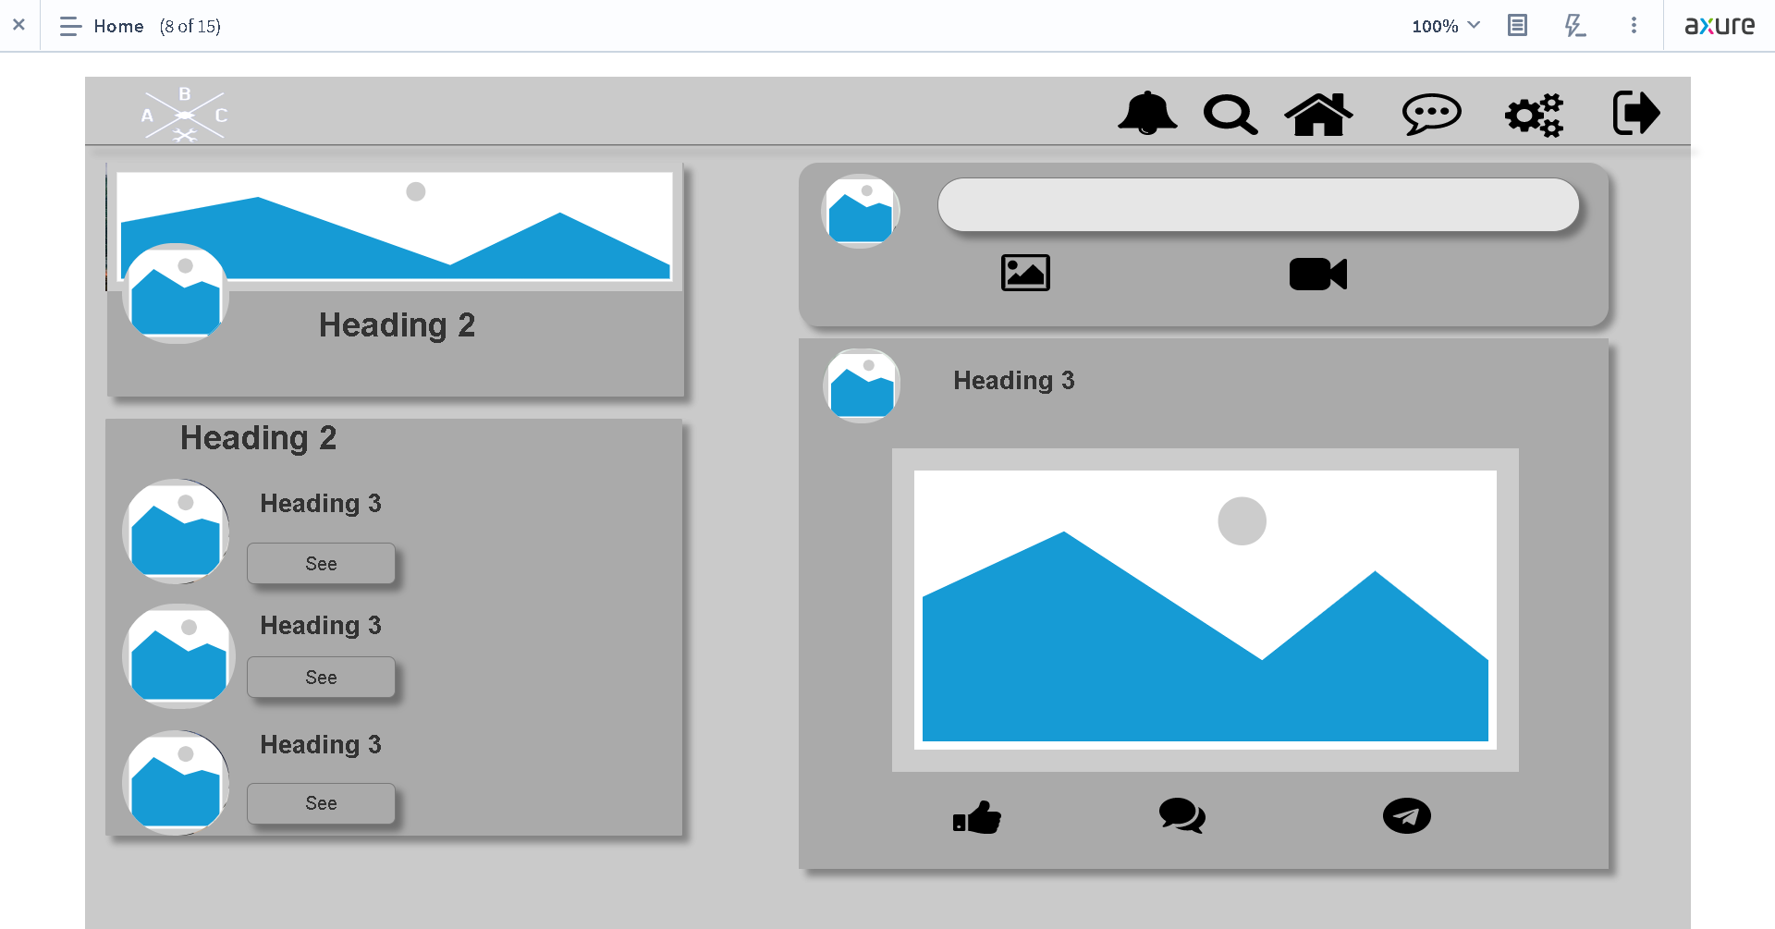
4. Forms & Pages Design

Slide 8
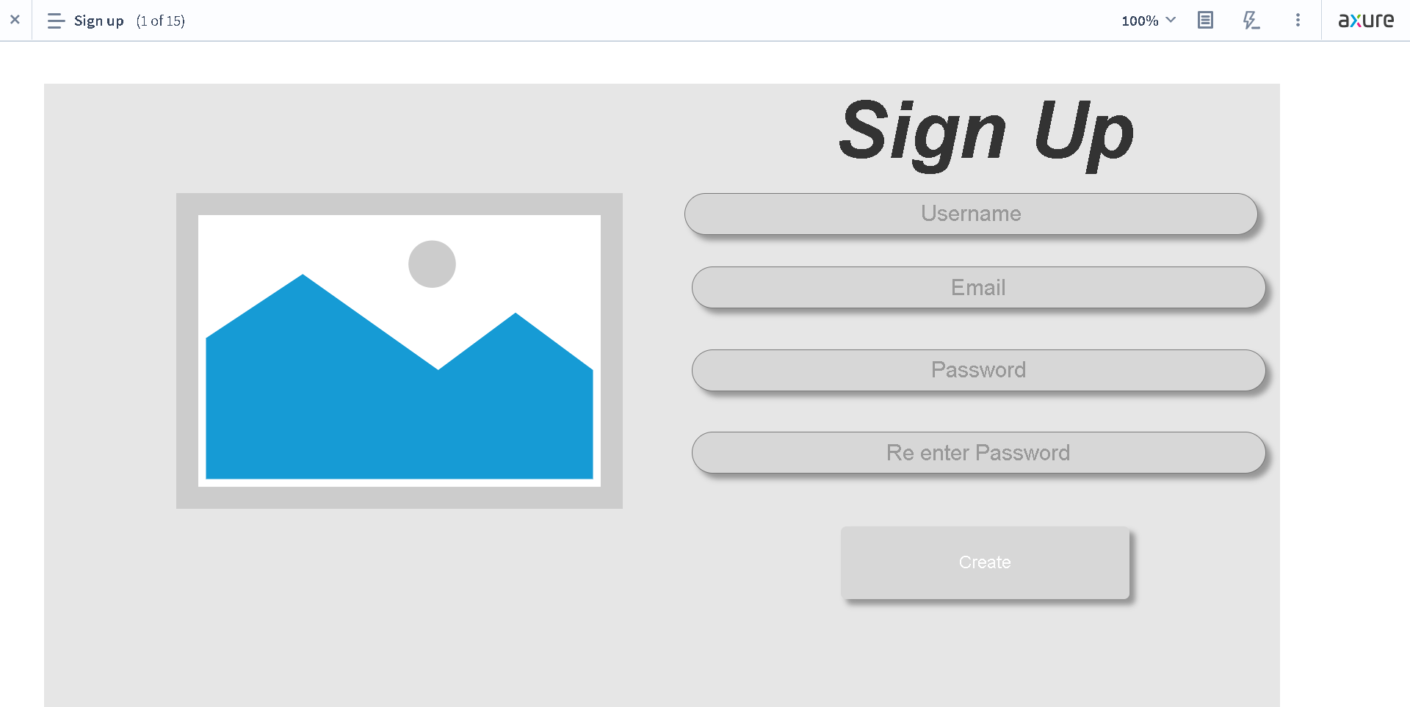
4. Forms & Pages Design

Slide 9
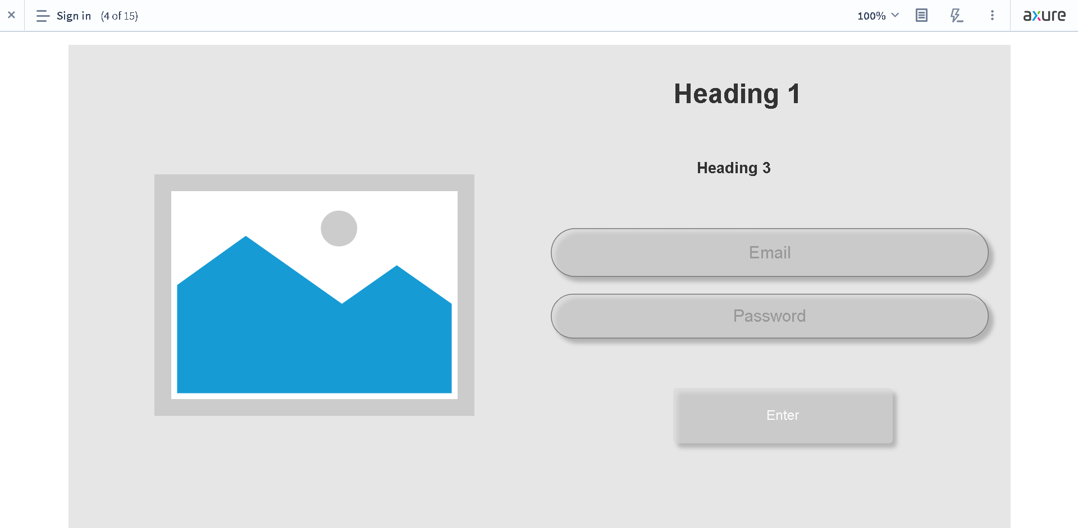
4. Forms & Pages Design

Slide 10
5. Forms & Pages Feedback
S. No. | Forms / Pages | Feedback Received | Modifications Implemented
1 | Community Portal Home Page | Everything Is Good | Everything Is Good
2 | Registration Page | Everything Is Good | Everything Is Good
3 | Registration Confirmation Page | Everything Is Good | Everything Is Good
4 | Update Profile Page | Everything Is Good | Everything Is Good
5 | Search Users Page | Everything Is Good | Everything Is Good
6 | List Search Results | Everything Is Good | Everything Is Good
7 | Public Profile Page | Must have Small Biodata, React, Comment, and Share button | Adding Small Biodata, React, Comment, and Share button
8 | Registration Confirmation Email | Everything Is Good | Everything Is Good
9 | Login Page | Everything Is Good | Everything Is Good
10 | Forget Password Page | Everything Is Good | Everything Is Good
11 | Design the Forget Password Confirmation Page | Everything Is Good | Everything Is Good

Slide 11
5. Forms & Pages Feedback
S. No. | Forms / Pages | Feedback Received | Modifications Implemented
12 | Dashboard Page | Not have follow suggestions, react, comment, and share button | Adding follow Suggestion, react, comment, and share button
13 | Thank You Page | Everything Is Good | Everything Is Good
14 | My Profile Page | Not have follow suggestions, react, comment, and share button | Adding follow Suggestion, react, comment, and share button
15 | Company Search Result Page | Not have job search result | Adding job search result

Slide 12

6. HTML Pages
In Module 3 IUF Summative Assessment Task there is no HTML Pages, we only make the prototype for ABC Jobs

Slide 13
7. Usability Metrics
There will be three metrics to measure the scenario task.
Time on Task (TOT)
It calculates the time it took the user to do the task. The usability is better when the faster time it takes. The average time of all participants will be used to compute the final score.
Task Success Rate (TSR)
Test the user's ability to finish the task. Overall participants, successful participants' final scores are displayed.
Customer satisfaction (CSAT)
KPI uses a valuable metric to express customer satisfaction. Very Unsatisfied, Dissatisfied, Neutral, Satisfied, and Very Satisfied were the categories on the scale. The final score is displayed in 6 using the formula below.
(number of satisfied)/number of respondents x 100%)

Slide 14
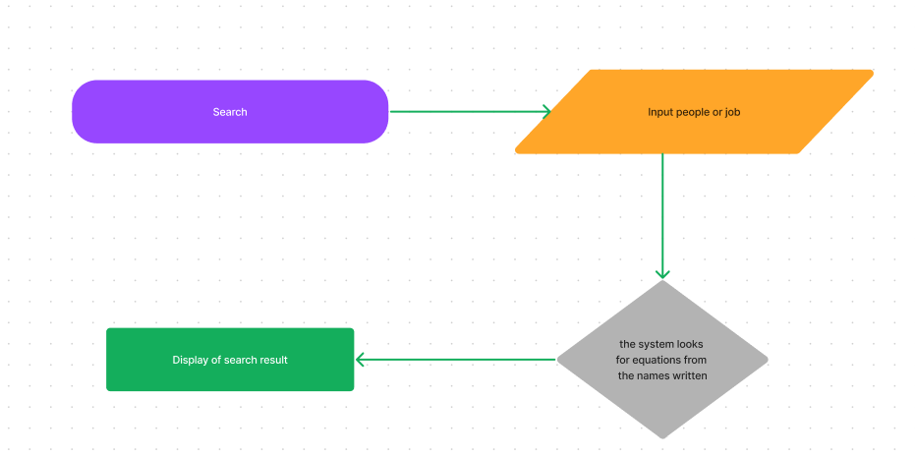
8-9. User Interaction Steps & Flowchart
Search Flowchart | Steps
 | In Search page , we click the search 2. Enter the name of the person or job 3. System will find the closest result 4. If user press enter, it will display all of the result

Slide 15
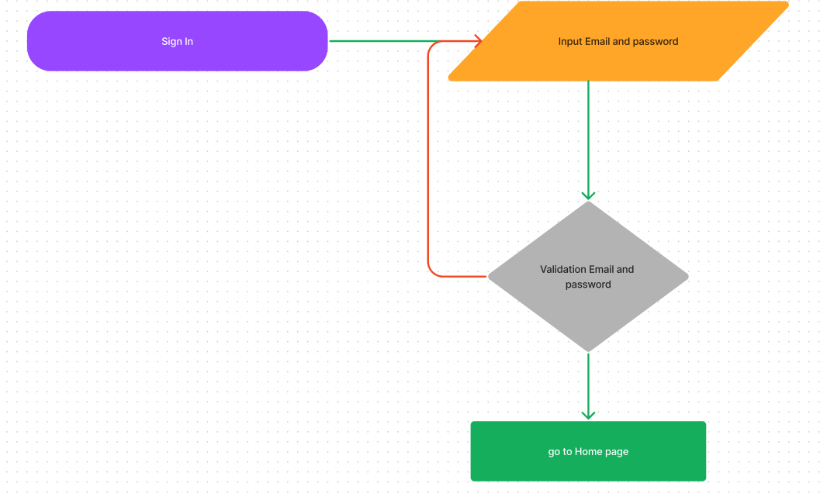
8-9. User Interaction Steps & Flowchart
Sign In Flowchart | Steps
 | 1. In Sign In, we fill the Email and password 2. Click Enter if correct then it will move to home Page

Slide 16
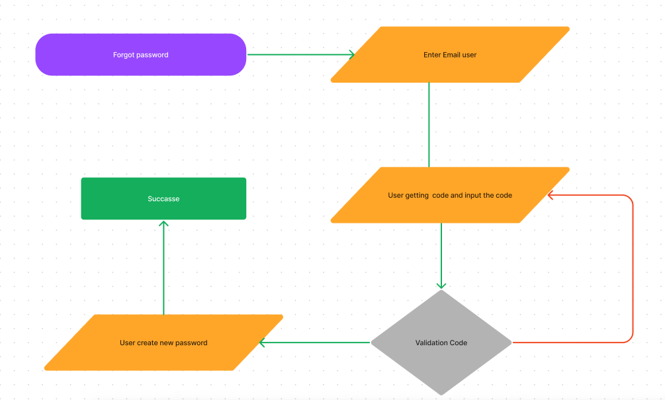
8-9. User Interaction Steps & Flowchart
Forgot Password Flowchart | Steps
 | 1. In forgot password, we Enter the Email 2. We will getting code 3. Input the code 4. If correct user can create new password

Slide 17
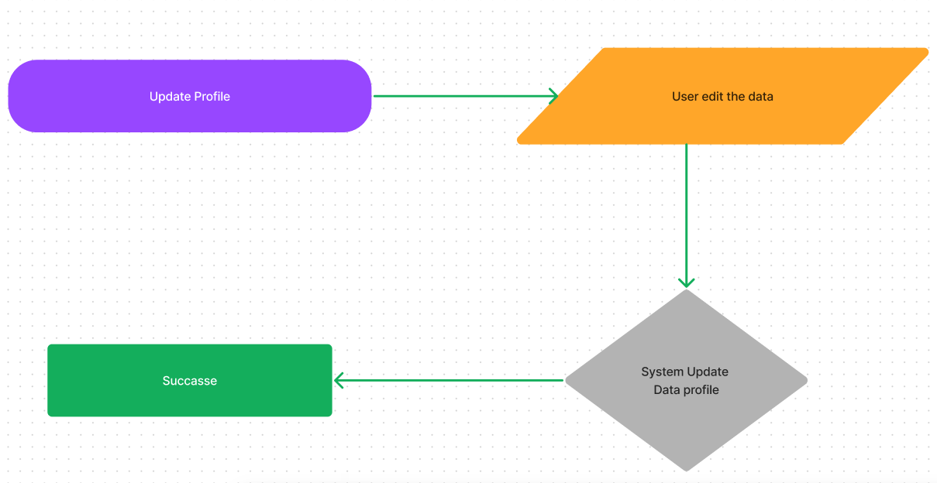
8-9. User Interaction Steps & Flowchart
Update profile Flowchart | Steps
 | 1. In profile, we click the button Edit 2. Enter the name, etc. 3. Click Edit and data has changed

Slide 18
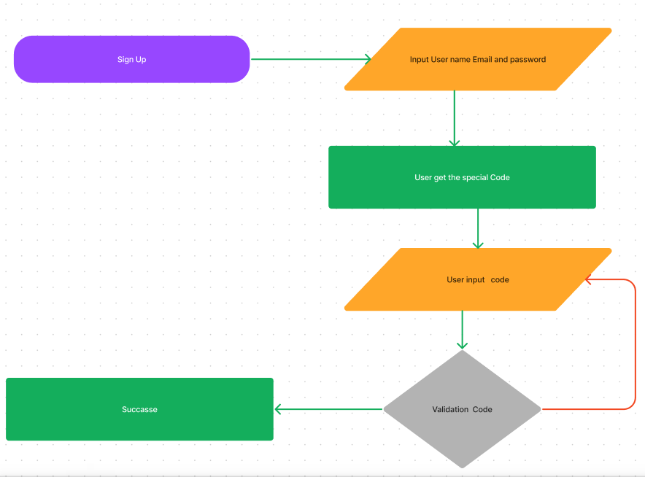
8-9. User Interaction Steps & Flowchart
Search Flowchart | Steps
 | 1. In navbar, we click the search field 2. Enter the name of the person or company 3. System will find the closest result 4.If user press enter, it will display all of the result

Slide 19
10. Current & Desired Usability
First Usability Test Using Task Success Rate
New account registration.
Result
Overall, they can do it without any problems but always ask for help step by step. But he can make it faster than Jujun.
They can navigate the community portal more easily.

Slide 20
10. Current & Desired Usability
Second Usability Test Using Customer Satisfaction
Sign in with a new account.
Result
They can do without any problems. All participants are familiar with the login form.
Task time is faster than registering because logging in only requires a small amount of data content compared to when they register

Slide 21
10. Current & Desired Usability
Third Usability Test Task On Time
Forgot password account.
Result
On average, there is no problem. They can pass this Three Uses Test
jujun has always been at a long time in the Three Usability Test.

Slide 22
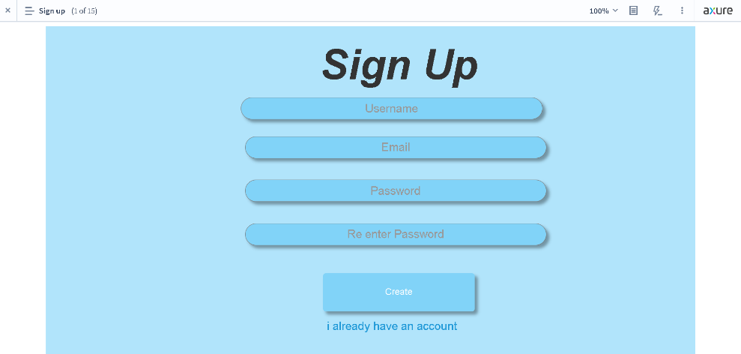
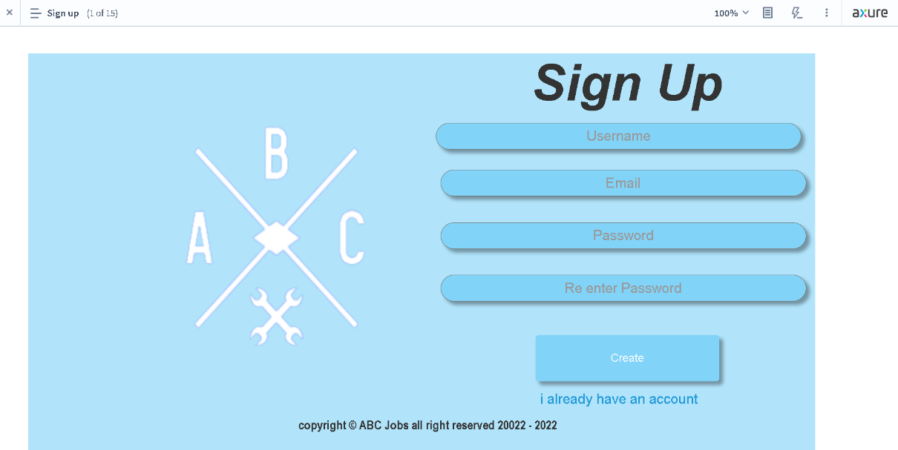
11. Prototype Screen
Beta Version
Final Version
Changes | Adding Logo and footer

Slide 23
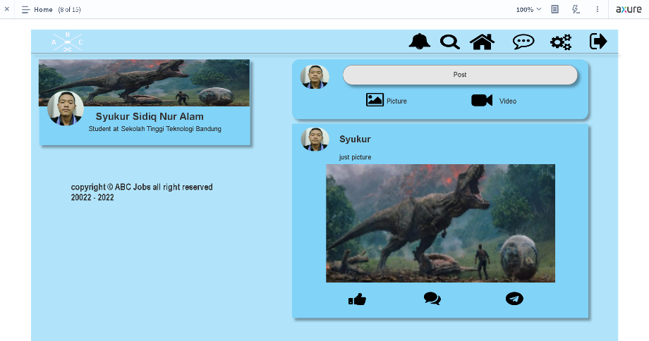
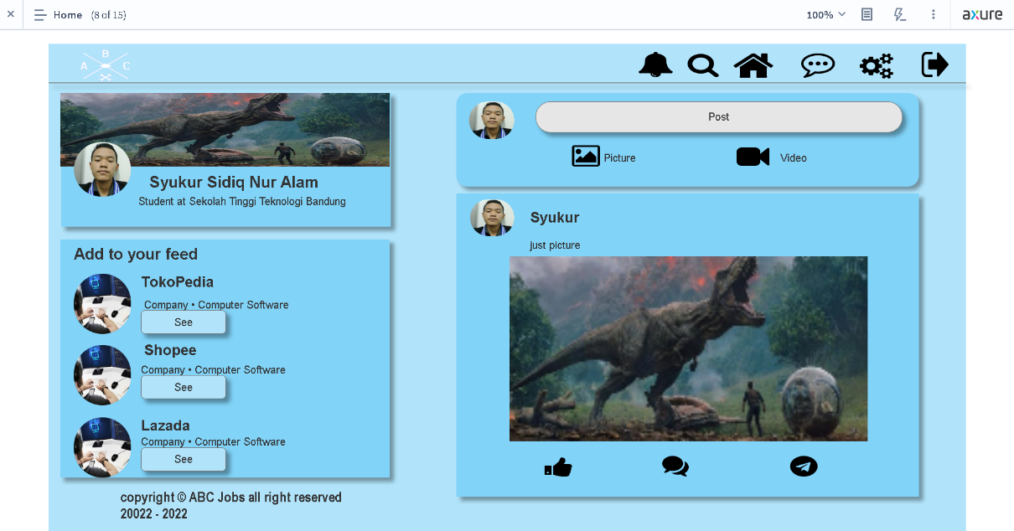
11. Prototype Screen
Beta Version
Final Version
Changes | Adding to your feed

Slide 24
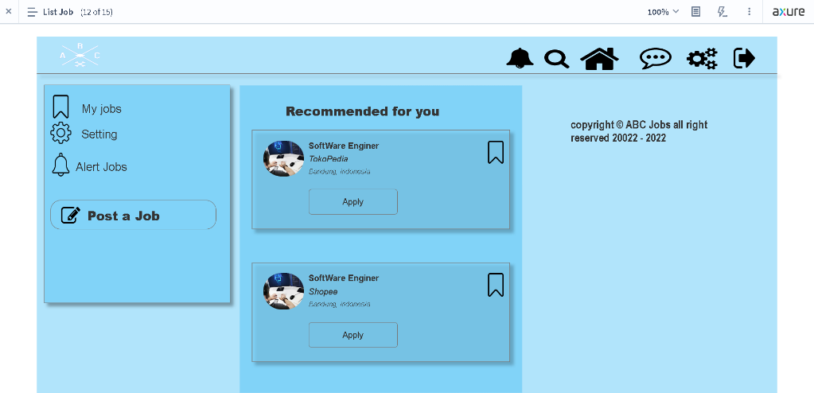
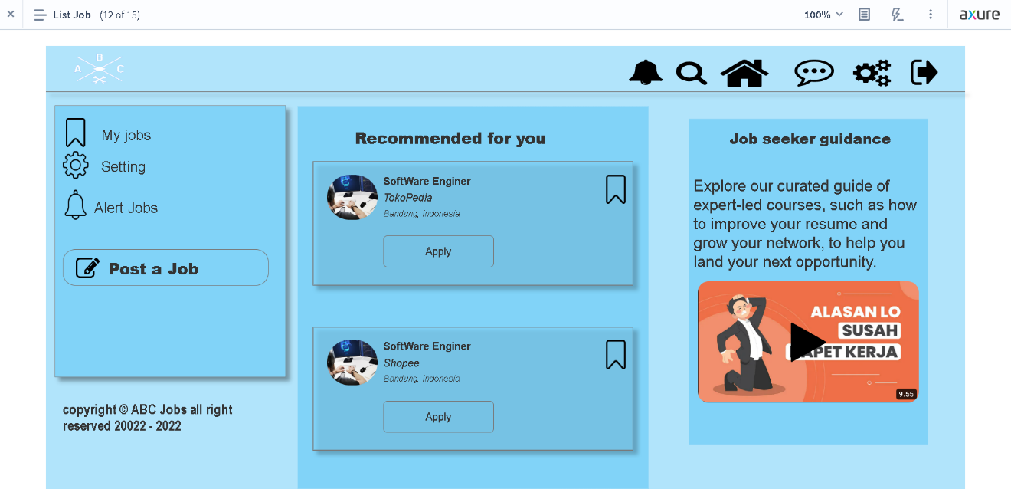
11. Prototype Screen
Beta Version
Final Version
Changes | Change posision Copyright Adding Recommended Job seeker guidance

Slide 25
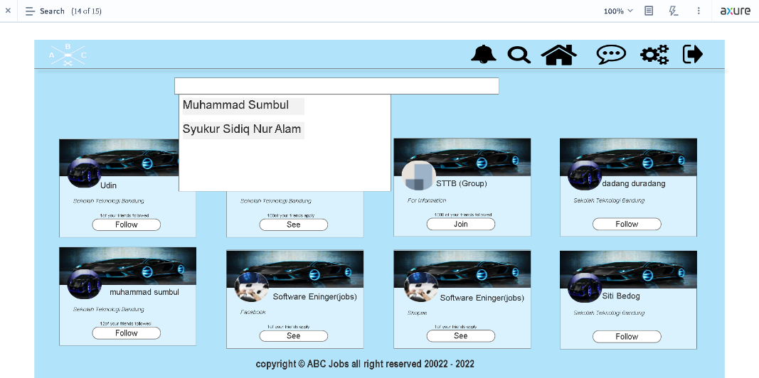
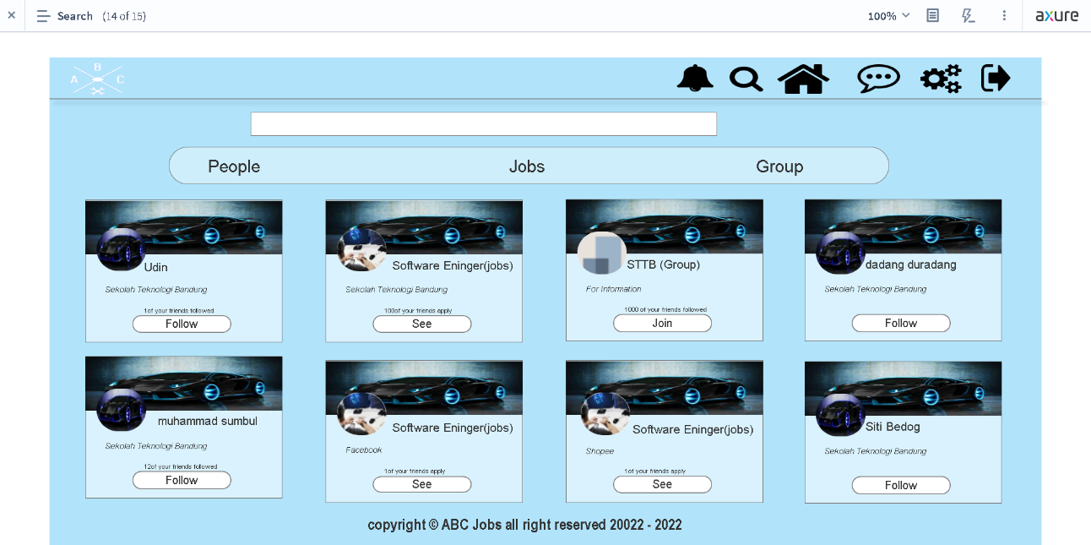
11. Prototype Screen
Beta Version
Final Version
Changes | Adding filter (people, jobs, group)

Slide 26
12. Prototype Feedback
No. | Before | After
1. | Picture logo, button, footer and less layout in the Homepage | Have more picture, layout and some button also footer
2. | Less some layout picture and copy right in Sign Page | Adding some layout picture and copy right in Sign Page
3. | Not have Recommended Job seeker guidance | Adding Recommended Job seeker guidance
4. | Not Have suggestions to follows | Adding suggestions to follows
5. | No job and group search result | Adding job and gorup search result
6. | Some button is not linking on the website | Make a button view my profile, edit profile, log out, and search have a function

Slide 27
13. Usability Test
First Usability Test
Update profile account
No. | User | TOT | TSR
1 | Agus | 40 seconds | Success
2 | Jujun | 47 seconds | Success
3 | Engkus | 38 seconds | Success
Average |  | 43 seconds | 100%
Second Usability Test
Login with new account.
No. | User | TOT | TSR
1 | Agus | 20 seconds | Success
2 | Jujun | 22 seconds | Success
3 | Engkus | 19 seconds | Success
Average |  | 21 seconds | 100%

Slide 28
13. Usability Test
Usability Test
Forgot password account.
No. | User | TOT | TSR | CSAT
1 | Agus | 28 seconds | Success | Very Satisfied
2 | Jujun | 30 seconds | Success | Very Satisfied
3 | engkus | 28 seconds | Success | Very Satisfied
Result |  | 29 seconds | 100% | 100%

Slide 29
14. Project Milestones & Tasks
Project Task ID | Project Task Description | Project Milestone ID
1 | Community Portal Home Page | 1
2 | Registration Page | 1
3 | Registration Confirmation Page | 1
4 | Page Login Page | 1
5 | Search Users Page | 1
6 | List Search Results | 1
7 | Public Profile Page | 1
8 | Registration Confirmation Email | 1
9 | Update Profile | 1
10 | Forget Password Page | 1
11 | Design the Forget Password Confirmation Page | 1
12 | List job page | 1
13 | Create job page | 1

Slide 30
15. Milestone Feedback & Action taken
Project Milestone ID | Milestone Feedback received from Tutor / Learning Facilitator | Action Taken (Yes / No)
1
2
3

Slide 31

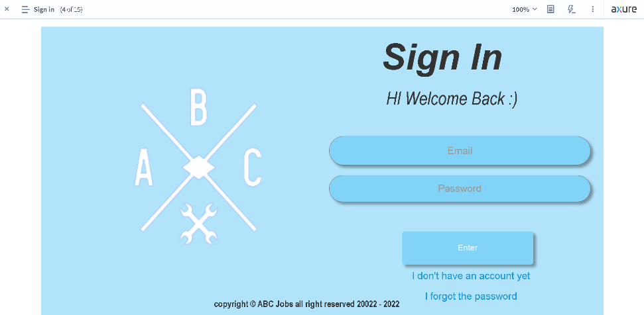
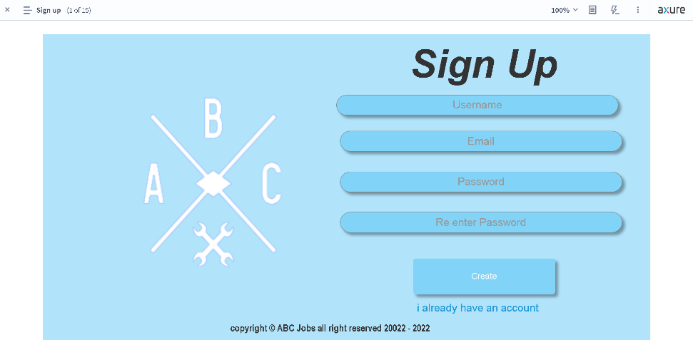
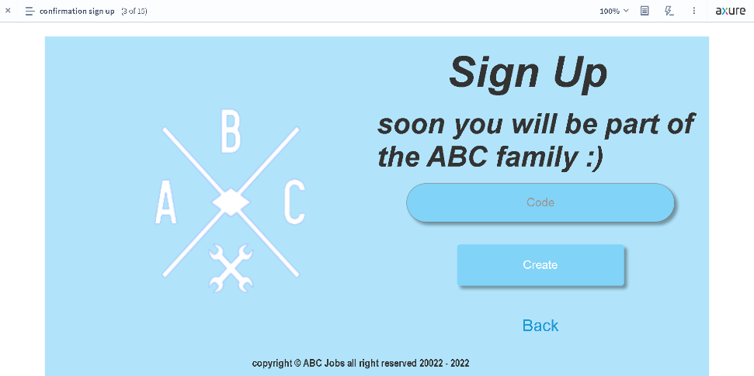
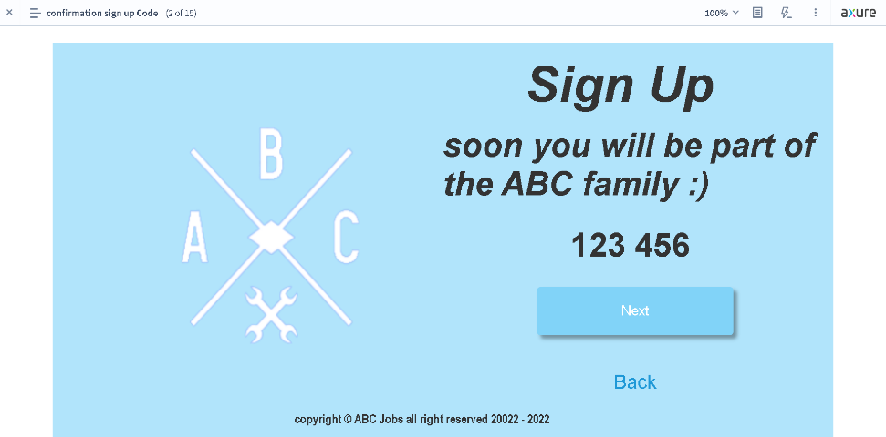
16. Project Results
Screen Capture

Slide 32

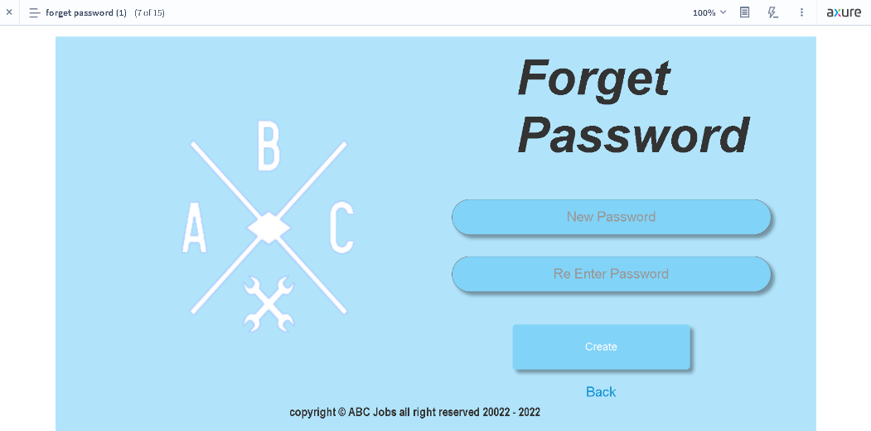
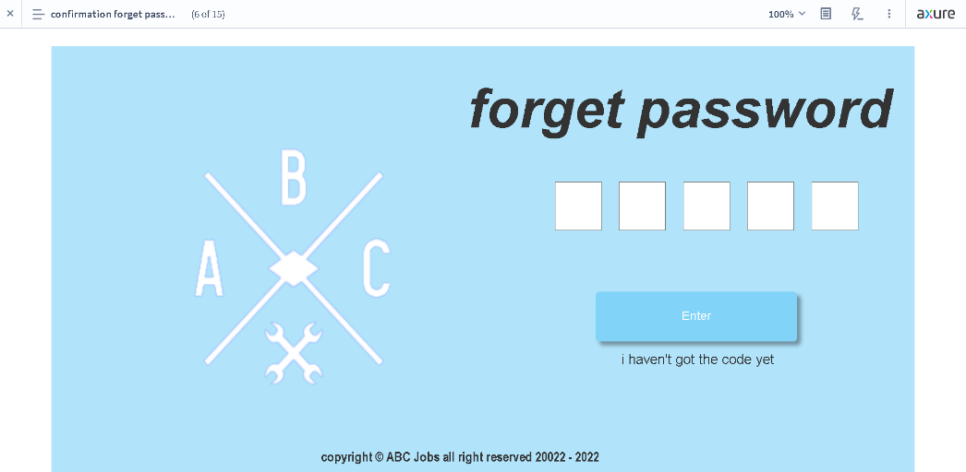
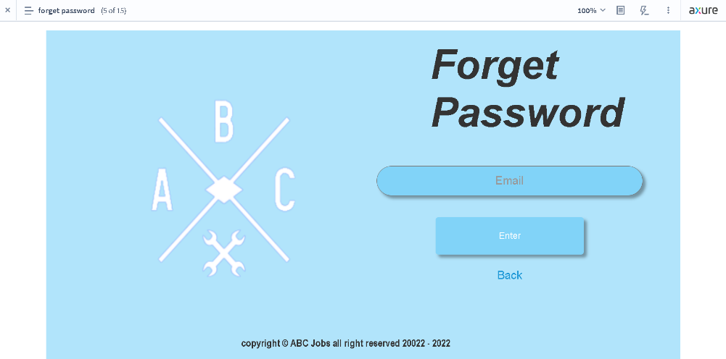
16. Project Results
Screen Capture

Slide 33
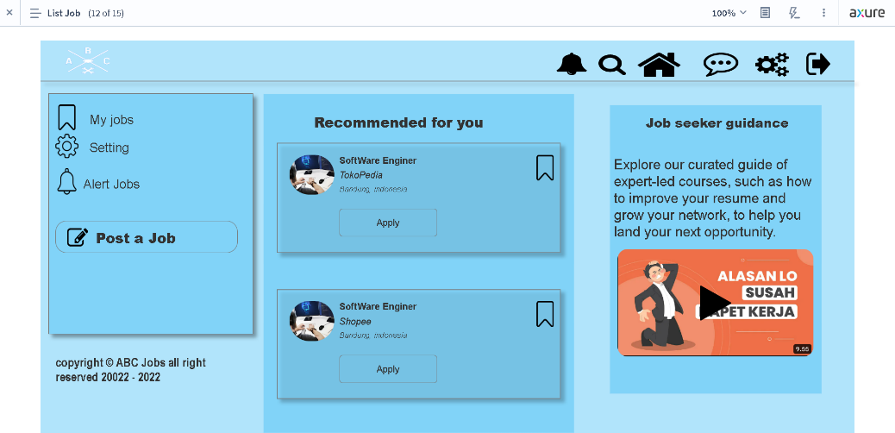
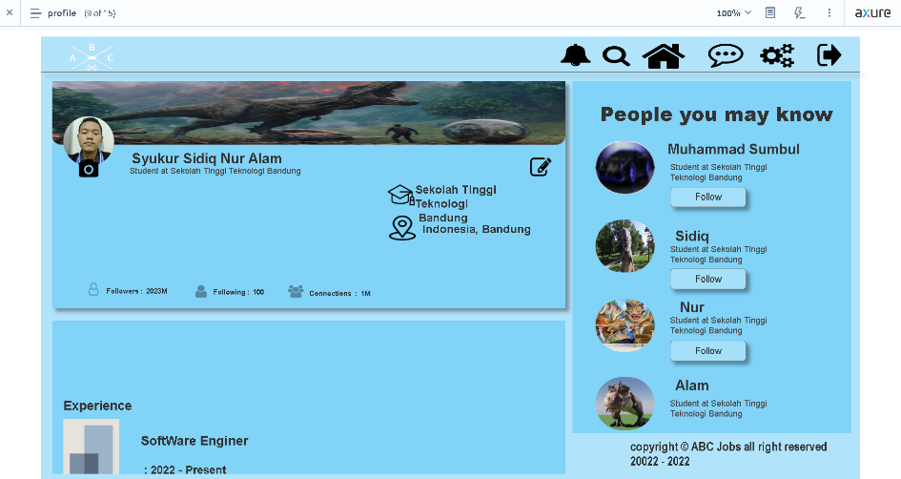
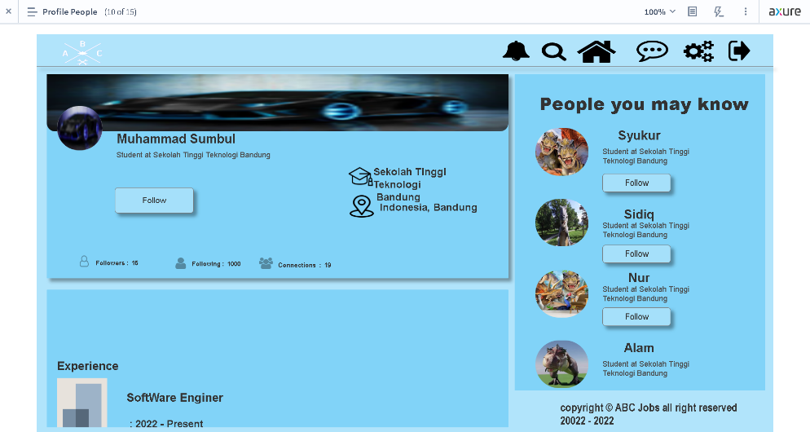
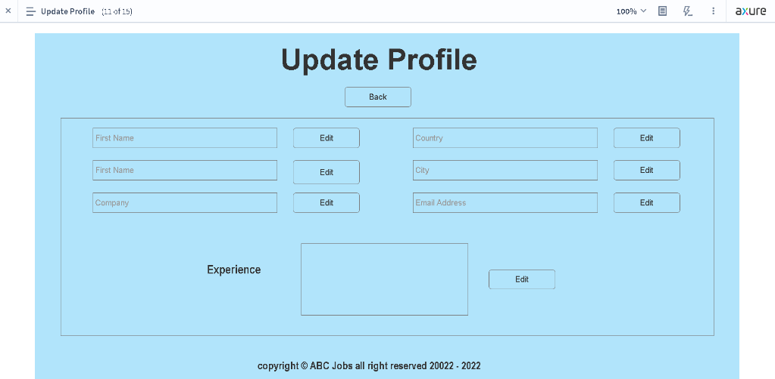
16. Project Results
Screen Capture

Slide 34

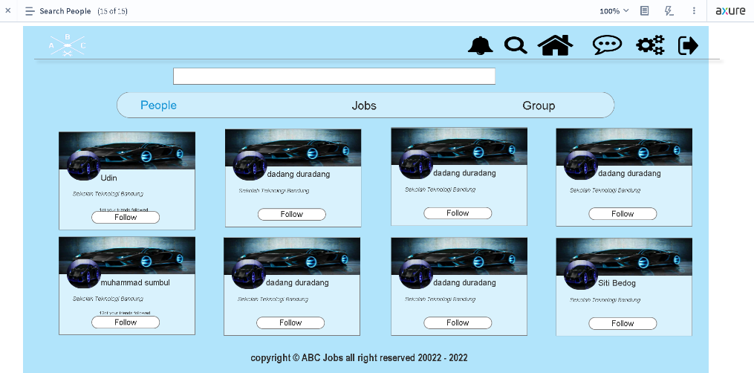
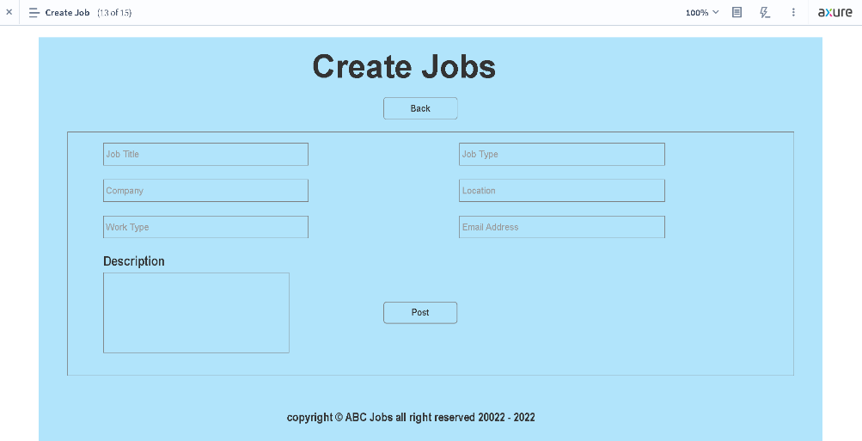
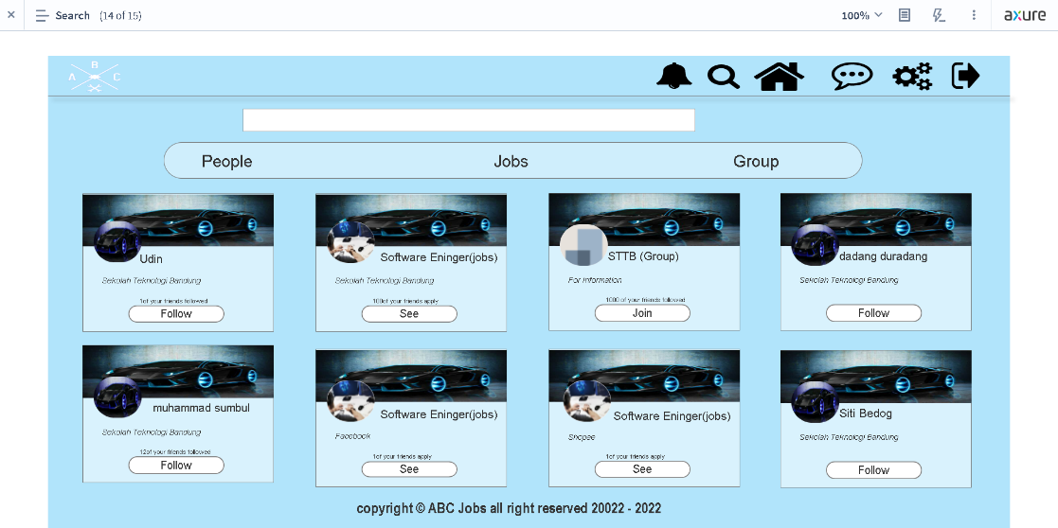
16. Project Results
Screen Capture

Slide 35

17. Proposed Improvements
List of Improvements
Need Improvement in color management
Need More Layout in prototype
Need More Features like sending messages etc.
Need to activate all the buttons that have been made

